Slide 1
Copyright Act
Group 6
Aastha Joshi 20020845001
Aishwarya Singh 20020845004
Harsh Tambe 20020845010
Joel Keith Pais 20020845011
Taksande Sandeep Ravindra 20020845030

Slide 2

What is Copyright?
A copyright is essentially a right not to copy someone’s work.
A copyright gives the owner of the subject an exclusive right over his work.
If a work is protected by copyright, no one can imitate, copy or reproduce the original work in any other way.

Slide 3
Reason to register a Copyright
Legal Protection
Branding and goodwill
Restricts any unauthorized reproduction
Global protection
Asset Creation

Slide 4
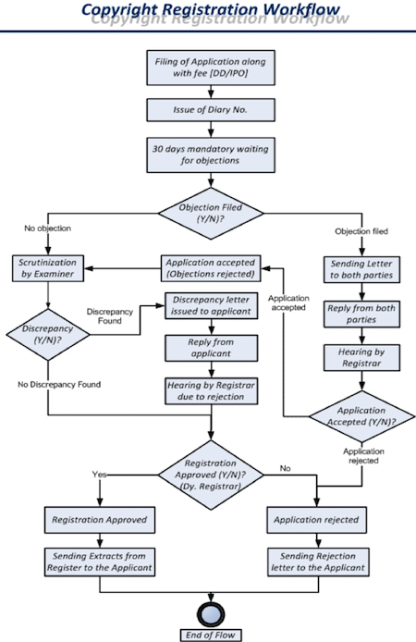
Procedure
Documents required
3 copies of the work if the work is published.
2 copies of manuscripts if otherwise if work is not published.
Special power of attorney or vakalatnama.
Authorization in respect of work, if the work is not the work of the applicant;
Information regarding the title and language of the work;
Information regarding the name, address and nationality of the applicant;
Applicant’s contact details.
If the applicant is not the author, a document containing the name, address and nationality of the author.
If the author is deceased, the date of his death;
If the work is to be used on a product, then a no-objection certificate from the trademark office.
If the applicant is other than the author, a no-objection certificate from the author.
If a person’s photo is appearing in the work, then a no-objection certificate from such person.
In case the publisher is not the applicant, a no-objection certificate from the publisher.
If the work is published, the year and address of first publication.
Information regarding the year and country of subsequent publications.
In case of copyright is for software, then source code and object code.

Slide 5
Step 1: File an Application
1. Filling the application
2. Payment of fees. (fees for registration ranges from Rs. 500 to Rs. 5000)
3. Registrar issues Diary number
Step 3: Final Step
Here the registrar might ask for more documents. Once satisfied, the Registrar issues a certificate of registration.
Step 2: Examination:
1. 30 days waiting period (min)
2. Considering copyright objections
3. In case of zero discrepancies, the applicant is allowed to go forward
4. In case of discrepancies, a letter of discrepancy is sent to the applicant
5. In case the discrepancy is not solved, the procedure ends here
Objections:
1. An objection may be raised for a number of reasons including: lack of distinctiveness, incorrect details found by the examiner etc
2. It is a legal obligation to file a response to the copyright objection letter. On not receiving any response, may result in rejection
3. The response to a copyright objection or discrepancy letter is a legal document, and requires basic minimum legal knowledge

Slide 6
Duration of Copyright
Administration of Copyright Law
Original literary, dramatic, musical and artistic works - the lifetime of the author or artist, and 60 years counted from the year following the death of the author.
Cinematograph films, sound recordings, works of government and works of international organisations - 60 years which is counted from the year following the date of publication.
Advisory body on copyright matters - Copyright Enforcement Advisory Council (CEAC).
No special courts for copyright cases, Copyright Board to adjudicate certain cases pertaining to copyright.
Powers of Copyright Board
Hear appeals against the orders of the Registrar of Copyright
Hear applications for rectification of entries in the Register of Copyrights
Grant compulsory licences to publish or republish works (in certain circumstances)
Hear and decide disputes as to whether a work has been published or about the date of publication or about the term of copyright of a work in another country
Fix rates of royalties in respect of sound recordings under the cover-version provision

Slide 7
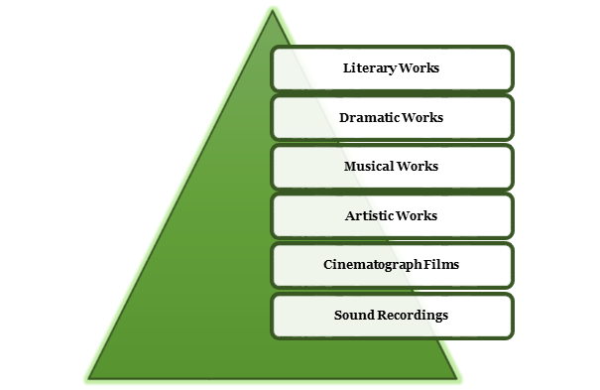
Types of Works Protected
Literary Works: Includes the original or unique creation of literature, which can be in any form like a work of fiction, technical books or paper, biography.
Dramatic Works: Includes any arrangement of acting a play, or a part for recitation.
Musical Works: Does not include any sound or lyrics, a separate application is required to be moved with the Copyright Office for the Registration
Artistic Works: Original artistic work comprising of sculptures, paintings, cartoons, graphics, lithographs, etchings, drawings, plans.
Cinematograph Films: work of visual recording together with the sound recordings accomplished by any process, whether digital or analogous, including the video films, visual recording in any medium and by any way of storing such visual recording.
Sound Recording: Any work of sound recording irrespective of its storage medium, the songs which contain singers voice with or without music, a recorded speech or an audi, or podcast.

Slide 8
THE COPYRIGHT MEANS AS EXCLUSIVE RIGHT:
In Literary Works
For reproducing the work
For issuing copies of the work to the public
For performing the work in public
For communicating the work to the public
For making sound recording or cinematograph film in respect of the work
For making any translation of the work
To make certain adaptations of work
In Dramatic Works
For reproducing the work
For issuing copies of the work to the public
For communicating the work to the public
For including the work in any cinematograph film
For making any translation of the work
To make any adaptation of the work
In Musical Works
For reproducing the work
For issuing copies of the work to the public
For performing the work in public
For communicating the work to the public
For making sound recording or cinematograph film in respect of the work
For making any translation of the work
To make any adaptation of the work

Slide 9
THE COPYRIGHT MEANS AN EXCLUSIVE RIGHT:
In Artistic Works
For reproducing the work
For issuing copies of the work to the public
For communicating the work to the public
For including the work in any cinematograph film
To make any adaptation of the work
In Cinematographic Films
For communicating the cinematograph film to the public
For selling or giving on hire or offer for sale or hire a copy of the film
For making a copy of the film, which includes a photograph of any image forming part thereof
In Sound Recording
For making any other sound recording symbolizing it
For selling or giving on hire, or offering for sale or hire, any copy of the sound recordings
For communicating the sound recordings to the common public

Slide 10
OWNERSHIP OF COPYRIGHT AND RIGHTS OF THE OWNER
Subject to the provisions of this Act, the author of a work shall be the first owner of the copyright.
Who is an author?
In relation to a literary or dramatic work, the author of the work;
In relation to a music work, the composer;
In relation to artistic work other than a photograph, the artist;
In relation to photograph, the person taking the photograph, the artist;
In relation to a cinematograph film or sound recording, the producer; and
In relation to any literary, dramatic, musical or artistic work which is computer- generated, the person who causes the work to be created.
Rights of the Owner
Reproduction
Distribution
Performing and Display
Recording
Motion Picture
Translation and Adaptation

Slide 11
Assignment of copyright
Owner may assign to any person the copyright, either wholly or partially and either generally or subject to limitations and either for the whole term of the copyright or any part thereof.
Assignment of copyright in any future work.
assignee of a copyright becomes entitled to any right comprised in the copyright
Legal representatives of the assignee are responsible, if the assignee dies before the work comes into existence.
Mode of Assignment - It should be in writing signed by assignor or by his duly authorized agent.
Disputes with respect to assignment of copyright
Transmission of copyright in manuscript by testamentary disposition
Right of author to relinquish copyright.
The author of a work may relinquish all or any of the rights comprised in the copyright in the work by giving notice in the prescribed from to the Registrar of Copyrights
It shall not affect any rights subsisting in favour of any person on the date of the notice.

Slide 12
Exceptions To Infringement Under Copyright Act, 1957
The following acts shall not constitute an infringement of copyright, namely
A fair dealing with any work, not being a computer programme
The transient or incidental storage of a work or performance purely in the technical process of electronic transmission or communication to the public
Transient or incidental storage of a work or performance for the purpose of providing electronic links, access or integration
The reproduction of any work for the purpose of a judicial proceeding or for the purpose of a report of a judicial proceeding
The reproduction or publication of any work prepared by the Secretariat of a Legislature or, where the legislature consists of two Houses, by the Secretariat of either House of the Legislature,
The reproduction of any work in a certified copy made or supplied in accordance with any law for the time being in force
The reading or recitation in public of reasonable extracts from a published literacy or dramatic work
The publication in a collection, mainly composed of non-copyright matter, bona fide intended for instructional use, and so described in the title and in any advertisement issued by or on behalf of the publisher

Slide 13
Exceptions To Infringement Under Copyright Act, 1957 [Contd.]
The performance, in the course of the activities of an educational institution, of a literary, dramatic or musical work by the staff and students of the institution
The causing of a recording to be heard in public
The performance of a literary, dramatic or musical work by an amateur club or society, if the performance is given to a non-paying audience, or for the benefit of a religious institution
The storing of a work in any medium by electronic means by a non-commercial public library, for preservation if the library already possesses a non-digital copy of the work
The making or publishing of a painting, drawing, engraving or photograph of a work of architecture or the display of a work of architecture
The use by the author of an artistic work, where the author of such work is not the owner of the copyright therein, of any mould, cast, sketch, plan, model or study made by him for the purpose of the work
The making of a three-dimensional object from a two-dimensional artistic work, such as a technical drawing, for the purposes of industrial application of any purely functional part of a useful device

Slide 14
Remedies available against copyright infringement in India
The Copyright Act 1957 provides three kinds of remedies - administrative remedies, civil remedies and criminal remedies
Administrative remedies - detention of the infringing goods by the customs authorities
Civil remedies - include injunctions, damages and account of profits
Criminal remedies - include imprisonment (up to 3 years) along with a fine (up to 200,000 Rupees)
Limitation Period: The limitation period for filing a suit for damages for infringement of copyright is three years from the date of such infringement

Slide 15
YASH RAJ FILMS PVT LTD (Plaintiff) Vs. SRI SAI GANESH PRODUCTIONS & ORS (Defendants)
Advocate : JAYANT K MEHTA
Decided on 8 July 2019 by the High Court at New Delhi
CASE 1
FACTS
A copyright infringement suit was filed against Sri Sai Ganesh Productions & others by Yash Raj Films Pvt Ltd on the grounds that it blatantly copied the movie “Band Baja Baarat” produced under the YRF banner and producing “Jabardasht” which showcased substantial and material similarities in terms of theme, concept, plot, character, sketches, story, script, form and expression amongst other things.
ISSUES
Whether copyright can subsist in a cinematography film independent of the underlying works that it is comprised of?
Whether the expression under section 14 to ‘make a copy of the film mean making physical copy of the film only? And between the two film is there a substantial and material similarity?

Slide 16
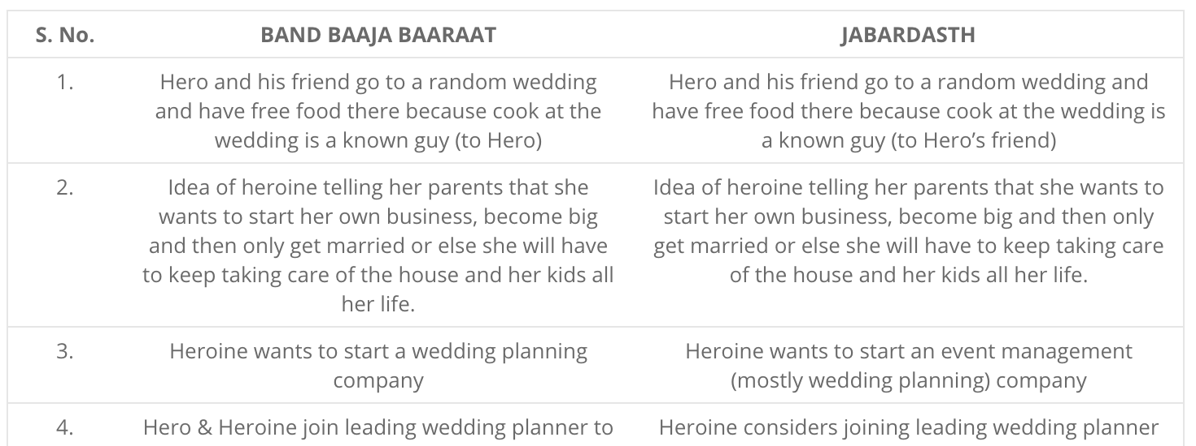
Judgment Analysis of Issue 1
The Court held that for the purpose of copyright law, a cinematograph film is seen in a wider perspective than just an assortment of its underlying works.
“underlying works” here refers to the different kinds of creative and original works that go into making an entire cinematograph film.
A cinematograph film as a whole is also entitled to be protected under the Act.
Referring to MRF Limited v. Metro Tyres Limited, CS(COMM) 753/2017, the Court held that even though a cinematograph film may not be infringing any of the underlying works, the film as a whole may not be copyrightable for want of ‘originality’.
Judgment Analysis of Issue 2
The Court further held that the expression “to make a copy of the film” under Section 14 (d) (i) of the Act.
Copying the idea, expression and other intangible aspects of an existing cinematograph film and incorporating them in another film.
Referring to the landmark case of R.G. Anand v. Deluxe Films, 4 SCC 118 (1978), “the substance, the foundation, the kernel” of the two films in question was compared.
Court found that the defendants, in their film Jabardasth, had blatantly copied the fundamental, essential and distinctive features of the plaintiff’s film, Band Baja Baarat
The defendant acknowledged the plaintiff to be the owner of the copyright in script, screenplay, dialogues and other works which could be copyrightable by the plaintiff.
Nineteen exact similarities between the two films were admitted on record.

Slide 17
Case 2
Demolition - A Limitation On Architect's Moral Rights
Raj Rewal (plaintiff) vs Union of India (defendant)
Decided on 28th May 2019 by the High Court at New Delhi
•Background
Mr. Raj Rewal designed the Hall of Nations building. I was hailed as an icon of modernist Indian architecture and was erected in the Pragati Maidan grounds in New Delhi.
The ITPO in 2016, made a proposal to demolish the Hall of Nations complex in order to build another structure.
Post demolition of the building the Plaintiff instituted a suit against the actions of ITPO by claiming that the actions of demolition had derogated the Plaintiff’s special rights under Section 57.
•Issue
Section 57 of the Copyright Act, 1957 provides the author with special rights called ‘moral rights’ which subsists with the author of the work over and above economic rights of others.
Whether an Architect, as the creator and legally the ‘author’ of a structure has a right vested in him to object to such modification or demolition of their work by the owner of the building?

Slide 18
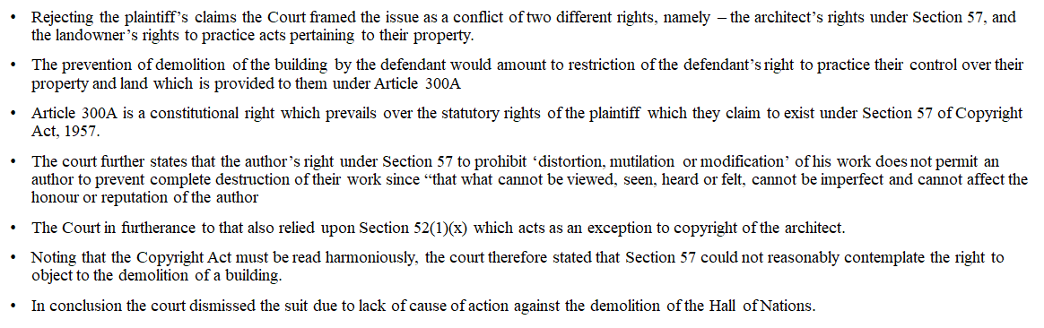
Judgement

Slide 19
References
https://cleartax.in/s/copyright-registration-india-explained
https://en.wikipedia.org/wiki/Copyright_law_of_India
https://copyright.gov.in/documents/copyrightrules1957.pdf
https://www.indiacode.nic.in/bitstream/123456789/1367/1/AAA1957___14.pdf
https://www.mondaq.com/india/copyright/655852/copyright-law-in-india-everything-you-must-know
https://www.intepat.com/blog/copyright/5-copyright-cases-2019-india/
http://www.legalserviceindia.com/article/l195-Copyright-Law-in-India.html
https://copyright.gov.in/documents/handbook.html#:~:text=The%20general%20rule%20is%20that,the%20death%20of%20the%20author.
https://corpbiz.io/learning/type-of-works-protected-by-copyright-in-india/
https://www.mondaq.com/india/copyright/823850/demolition--a-limitation-on-architect39s-moral-rights#:~:text=In%20Raj%20Rewal%20v%20Union,basis%20of%20his%20moral%20rights.
https://copyright.gov.in/frmWorkFlow.aspx
https://blog.ipleaders.in/copyright-registration/#Essential_documents_required_for_copyright_registration
https://vakilsearch.com/advice/replying-to-a-copyright-objection/
https://copyright.gov.in/Exceptions.aspx
https://www.education.gov.in/hi/sites/upload_files/mhrd/files/upload_document/CprAct.pdf
https://www.lexology.com/library/detail.aspx?g=96a0fc1e-d8de-4efe-9f7b-d9ed17752bc4#:~:text=civil%20remedies%20%2D%20these%20provide%20for,copies%20to%20the%20owner%3B%20and
https://www.obhanandassociates.com/blog/copyright-in-perpetuity/#:~:text=In%20India%2C%20under%20the%20Copyright,year%20after%20the%20author's%20death

Slide 20
THANK YOU

